Slide 1
Topics
Introduction
Linux Kernel
Introduction to Shell
Linux Distribution
Linux Filesystem
Basics Shell Commands
File/Directory Management Commands
File Permissions
Few more commands..

Slide 2
Introduction
Linux is basically a kernel, it was combined with the various software and compilers from GNU Project to form an OS, called GNU/Linux.
Linux is a clone of Unix and it is multi-user, multi tasking and multi-threading supporting operating system.
In Linux, a kernel that handles all the background OS tasks.
Linux is the most used OS on servers.

Slide 3
Linux Kernel
Kernel is the heart of the Linux OS
Handles all background OS tasks
Kernel interacts with the Hardware
First program to get loaded when the system starts and runs till the session gets terminated

Slide 4
Shell
Program that interact with the Kernel
Bridge between kernel and the user
Command Interpreter
User can type command, and the command is conveyed to the kernel and it will be executed.

Slide 5
Types of Shell
Sh – Simple shell
Bash – Bourne Again Shell
KSH – Korne Shell
CSH – C Shell
SSH – Secure Shell
To use a particular shell type the shell name at the command prompt.
To view the available shells in the system, type cat /etc/shells at the command prompt.
To view the current shell that is being used, type echo $SHELL at the command prompt

Slide 6
Linux Distributions
Redhat
Fedora
Debian
Novell’s SUSE Linux
Ubuntu
Mandrake
Etc..

Slide 7
Filesystem
In Linux, files are ordered in a tree structure starting with the root directory.
Root directory can be considered as the start of the file system. Root is denoted with a forward slash(/).

Slide 8
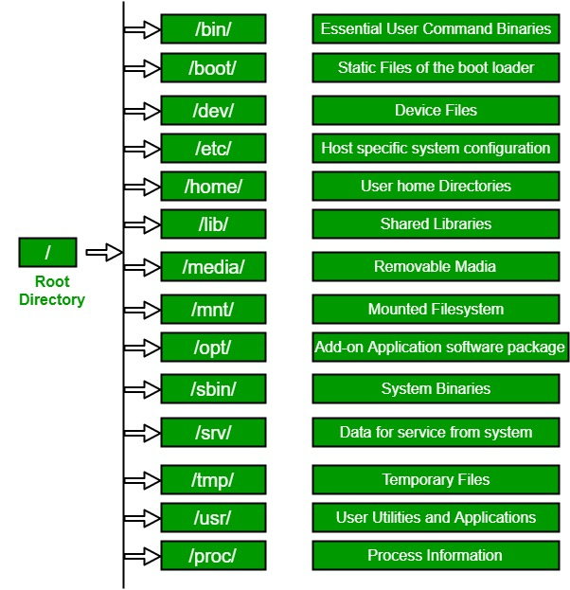
Filesystem

Slide 9
Basics Commands
date
  Print current date and time
who
  List users currently logged in to the system
  $ who
who am i
  $ who am i
man
  $ man <command name>
  Displays the shell command help manual

Slide 10
Directory management commands
pwd
  Print Working Directory
  Displays the full pathname for the current working directory.
  $ pwd
ls
  List the contents of the current directory or given directory
  $ ls
  $ ls <directorypath>
  $ ls -l : long listing

Slide 11
Directory management commands
mkdir
  Create a sub-directory
  $ mkdir <dirname>
cd
  Change the working directory
  $ cd <dirname>
  $ cd ..
  $ cd /

Slide 12
Directory management commands
rmdir
  Used to remove only empty directories.
  $ rmdir <dirname>
rm
  Delete non-empty directories
  $ rm -rvf <dirname>
    -r : recursively remove subdirectories
    -v : verbose output
    -f : to ignore-non existent files.

Slide 13
File management commands
File /Directory name is case-sensitive
cat
  Display the contents of the file
  $ cat <filename>
Using cat to create new files
  $ cat > filename <Enter>
  Enter data
  Press CTRL + D to save the file

Slide 14
File management commands
cp
  Copy the contents of the file
  $ cp <sourcefile> <destinationpath>
rm
  Delete files or directories
  $ rm <filename>
  $ rm -i <filename> : Ask permission
  $ rm -f <filename> : dont ask permission

Slide 15
File management commands
mv
  Move file from one location to another.
  Also used to rename files
  Also used to rename directories
  $ mv <SourceFilename> <DestinationPath>
  $ mv <SourceFilename> <NewName>

Slide 16
File Permissions
Linux is a multi-user operating system, which can be accessed by many users simultaneously.
For effective security, Linux divides authorization into 2 Levels.
  Ownership
  Permissions

Slide 17
Ownership of Linux files
Every file and directory in our Linux system is assigned 3 types of owner
  User
    A user is the owner of the file. By default, the person who created a file becomes its owner.
  Group
    A user group can contain multiple users. All users belonging to a group will have the same access permissions to a file
  Others
    Any other user who has access to a file.

Slide 18
Permissions
Every file and directory is your LINUX system has following 3 permissions defined for all the 3 owners
  Read
    This permission give you the authority to open and read a file. Read permission on a directory gives you the ability to lists its content.
  Write
    The right permission gives you the authority to modify the contents of a file. The write permission on a directory gives you the authority to add, remove and rename files stored in the directory.
  Execute
    In Linux, you cannot run a program unless the execute permission is set.

Slide 19
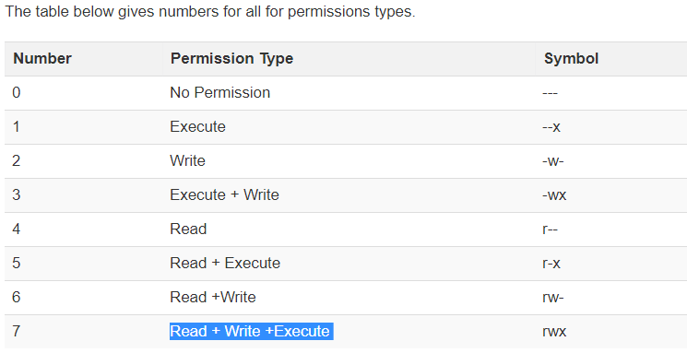
chmod
Changing file/directory permission using 'chmod' command
$ chmod 764 filename
$ chmod -R 764 directory

Slide 20
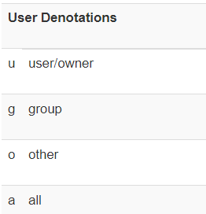
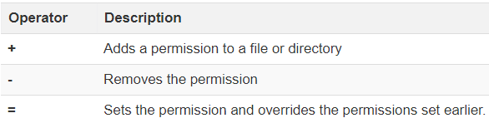
Symbolic Mode
In symbolic mode you can modify permissions of a specific owner.
  $ chmod u+rwx filename
  $ chmod u-x filename

Slide 21
find command
The easiest way to find a file.
  $ find <startfolder> -name <filename>
Finding empty files and folders
  $ find / -empty
Find using pattern
  $ find / -name *.mp3

Slide 22
grep command
Search for a string in a file
  $ grep “this” filename
Case sensitive search
  $ grep -i “This” filename
Check for full word, not substrings
  $ grep -iw “is” filename
Searching in all files in a directory
  $ grep -r “This” *
Displays that do not match
  $ grep -v “This” filename

Slide 23
grep command
Count the number of matches
  $ grep -c “This” filename
Count that do not match
  $ grep -v -c “This” filename
Displays the filenames that contains the match
  $ grep -l “This” *

Slide 24
Linux process management
An instance of a program is called a Process.
top
  This utility tells the user about all the running processes on the linux machine
ps
  Process status, similar to windows task manager. This command is same as top, but the information displayed in different.
  $ ps
  $ ps <PID>

Slide 25
Linux process management
kill
  This command terminates a running process on a Linux machine.
  To kill a process PID is required.
  $ kill <PID>
nice
  Linux can run a lot of processes at a time, which can slow down the speed of some high priority processes and result in poor performance.
  To avoid this, you can tell your machine to prioritize processes as per your requirements. This priority is called niceness in linux and it has a value betwenn -20 and 19
  The default value of all the process is 0.
  $ nice – n 19 <processname>
  $ renice 0 -p <PID>

Slide 26
Linux Process management
df
  This utility reports the free disk space on all file systems
  $ df -h
free
  This command shows the free and used memory on the Linux system
  $ free

Slide 27
ifconfig
  With this command we can view ipaddress, MAC address assigned to the system
  $ ifconfig
Ping
  Best way to test connectivity between nodes
  $ ping
less
  Less command allows to quickly view files. You can pageup and pagedown. Press 'q' to quit
  $ less <filename>

Slide 28
More
  More command allows quickly view file and shows details in percentage. You can pageup and pagedown. Press 'q' to quit.
wget
  To download files to local disk
  $ wget “url”
apt-get
  To install new packages
  $ apt-get install <packagename>

